Slide 1

Artificial NEURAL NETWORKS and DEEP LEARNING __________________________________________________________________________________________________________________________________________________________________________________________________________________________________________________________________________ Networking: intrusion Detection SYSTEM (IDS)
Presented by
Adam Leonard Hubble

Slide 2
Overview
Problem Definition
Methodology
Dataset Composition Analysis
Data Pre-processing
Experimental Design
Model Architecture
Numerical Results
Conclusion
Future Work

Slide 3
Problem Definition
Develop an Artificial Neural Network (ANN) capable of detecting and classifying network intrusions
Differentiate between ‘bad’ connections, intrusions or attacks, and ‘good’, ordinary connections
Ten-percent of the KDD Cup 1999 dataset used for training and testing model
Dataset features an assortment of intrusions simulated in a military network environment

Slide 4
Methodology
Python programming language
Faster development rate (familiarity)
Effective system integration support
Predominant presence in Machine Learning (ML) field
Google Collab
Natural Language Processing (NLP)
Convenient Python platform
Server-side computation power (faster compilation)
Experimental approach to model design

Slide 5
Dataset Composition Analysis
To inform the configurative state of the model being purposed
Identify categorical, numerical (and binary) features of the dataset (feature mapping)
Identify outlying and correlative features of the dataset
Dataset structure
494021 rows
41 columns or features
41-dimensional dataset (41 features)
23 different types of connection classifications
Representative of: Denial-of-Service (DoS), Normal, Probe, Remote-to-Local (R2L) and User-to-Root (U2R), intrusion types
Each of the 23 connection classifications are mapped to their respective category

Slide 6
Dataset Pre-processing (1 of 2)
Dataset complexity reduction
Remove features which have little or no impact on classification
Enhanced model training times
Enhanced model classification accuracy
Remove missing values (null)
Remove highly correlative features
Remove constant features (one value)
Principal Component Analysis (PCA)
Feature elimination
Pearson Correlation Coefficient (PCC)

Slide 7
Dataset Pre-processing (2 of 2)
Feature mapping
Categorical data types to numerical (discrete) types
Label encoding
Categorical ‘dummy’ features – provides a way of using categorical predictor variables in various kinds of estimation models
‘One hot encoded’ vector types – normal connection [0 1 0 0 0]
Target category
Binary: DoS = 1, normal = 0, Probe = 1, R2L = 1 and U2R = 1
Multiclass: label encoded and dummied
Feature normalisation
Relativise values
Reduced feature space complexity = enhanced model training times

Slide 8
Experimental Design
Feature removal technique alteration
Feature removal (correlation) technique threshold value alteration
Training and testing subset partition alteration
Model architectural tuning
Number of fully-connected layers (FCL’s),
Number of neurons comprising each FCL
Active optimiser algorithm – update attributes of model such as weights and learning rate in order to reduce the losses (prediction error) calculated
Model hyperparameter tuning
Batch size – amount of sample data parsed (rows) by the model per epoch
K-fold Cross Validation (CV)
Dataset fold count: acknowledge and address the model’s generalisation capabilities, when used to make predictions about samples of data that have not been used during training

Slide 9
Model Architecture (1 of 2)
Multiclass Classification Model
Sequential model – stack of layers, each layer has exactly one input tensor (connection features) and one output tensor (intrusion or attack type)
5 FCL’s
[32, 32, 32, 32, 5] topology (neurons per layer)
[relu, relu, relu, softmax, sigmoid] transfer (activation) functions (per layer)
Categorical cross-entropy loss function – measures the performance of the categorical-output type classification model (how far predicted probability diverges from the actual label)
Batch size: 128
Model parameter optimiser algorithm:
Adam – adaptive learning rate; combines the best properties of the AdaGrad and RMSProp algorithms to provide an optimisation algorithm that can handle sparse gradients on noisy problems
Early stopping loss monitoring – specify number of training epochs and stop training once the model performance stops improving; too many epochs can lead to overfitting of the training dataset, whereas too few may result in an underfit model

Slide 10
Model Architecture (2 of 2)
Binary Classification Model
Sequential model – stack of layers, each layer has exactly one input tensor (connection features) and one output tensor (intrusion or attack type)
5 FCL’s
[50, 50, 50, 50, 5] topology (neurons per layer)
[relu, relu, relu, softmax, sigmoid] transfer (activation) functions (per layer)
Binary cross-entropy loss function – measures the performance of the binary-output type classification model (how far predicted probability diverges from the actual label)
Batch size: 128
Model parameter optimiser algorithm:
Adam – adaptive learning rate; combines the best properties of the AdaGrad and RMSProp algorithms to provide an optimisation algorithm that can handle sparse gradients on noisy problems
Early stopping loss monitoring – specify number of training epochs and stop training once the model performance stops improving; too many epochs can lead to overfitting of the training dataset, whereas too few may result in an underfit model

Slide 11
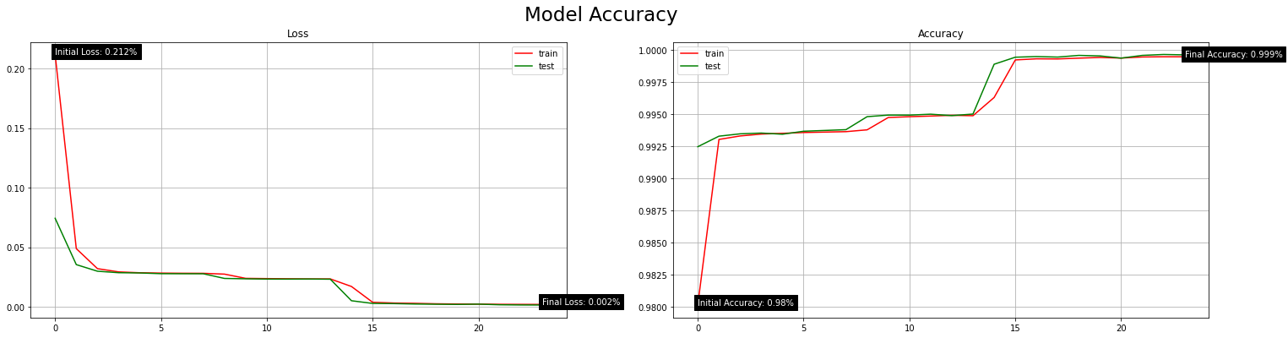
Numerical Results (1 of 2)
Binary Classification Model
Loss (error): 0.002
Accuracy: 99.96%
Model Loss (Error) | Model Accuracy (%)
0.002 | 99.96%

Slide 12
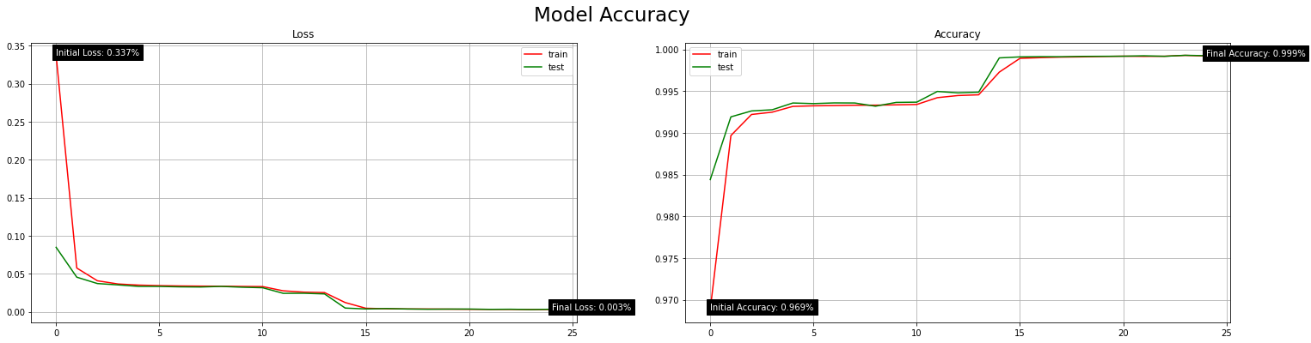
Numerical Results (2 of 2)
Multiclass Classification Model
Loss (error): 0.004
Accuracy: 99.93%
Model Loss (Error) | Model Accuracy (%)
0.004 | 99.93%

Slide 13
Conclusion
Learning Outcomes
Dataset analysis qualities
Expanded knowledge of the application of ANN’s
Neural Network (NN) model design, configurative and evaluative procedures
Model Evaluation
Accurate binary and multiclass IDS models
Promising results and configurative natures

Slide 14
Future Work
Fine-tuning the model(s)
Test all possible combinations of layer transfer function
Test all possible combinations of neuron counts in each layer
Development prospects
Trial other K-fold Cross Validation (CV) techniques
Trial other Neural Network (NN) models to classify connections
Optimisation algorithm integration for optimal hyperparameter tuning
Support for higher classification fidelity by intrusion or attack type
Already functioning, model not optimised however!

